Slide 1

Skills prediction based on multi-label resume classification using CNN with model predictions explanations
Kameni Florentin Flambeau Jiechieu
& Norbert Tsopze
University Of Yaounde 1
Published on 18 August 2020
Springer-Verlag London Ltd., part of Springer Nature 2020
Team
Seyed Ali Shahrokhi
Sara Aali
Ali NikFekr Sina Eyvazi

Slide 2
Dataset Description
The Dataset given in the paper is from https://github.com/florex/resume_corpus
It has three files :
resumes_corpus.zip This file contains a set of resumes files with the extension ".txt" with the corresponding list of labels in a file with the extension .lab.
resumes_sample.zip This file represents the dataset of resumes in a single text file. Each line of the file contains informations about a text resume. Each line has 3 fields separated by ":::". The first field is the reference id of the resume; the second field is the list of occupations separated by ";" ; and the third field is the text resume.
normalized_classes This file contains the associations between the occupations as written by the experts and their corresponding normalized form.

Slide 3
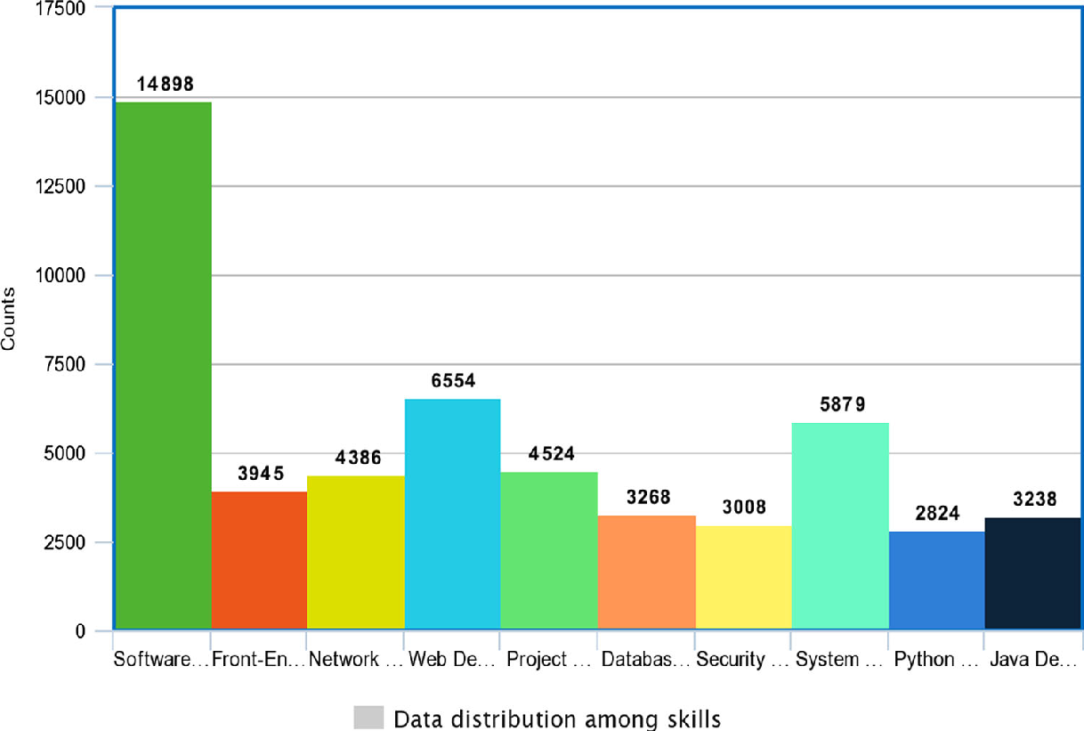
Descriptive data analysis
Fig.1 Classes distribution in the dataset
Theory 01
The experiments were carried out on a collection of 29,783 anonymous resumes
Theory 02
The number of pages of resumes
ranges from 1 to 6.
Theory 03
The extracted resumes are all from the
IT domain and are related to the competences stated in Fig.1
Software_Developer, Front_End_Developer, Network_Administrator, Web_Developer, Project_manager, Database_Administrator, Security_Analyst, Systems_Administrator, Python_Developer, Java_Developer
Classes

Slide 4
Preprocessing
Filtering Method | Max WC | Min WC | Avg Wc
No filtering applied | 17 | 12479 | 948
Stopwords filtering | 0 | 9809 | 724
Domain words selection | 0 | 5526 | 450
1
2
Skip Gram Algo Predictions
For Word ‘HTML’
Words are tokenized and punctuations removed
All stopwords are removed from raw text resume.
Domain Word Selection is used to select words related to resume from given dictionary skills.txt derived from dice.com/
We used the skip-gram algorithm to train our own
word embedding model
The word embedding model used in this work was built using a embedding dimension of 100 and a windows size of 5.

Slide 5
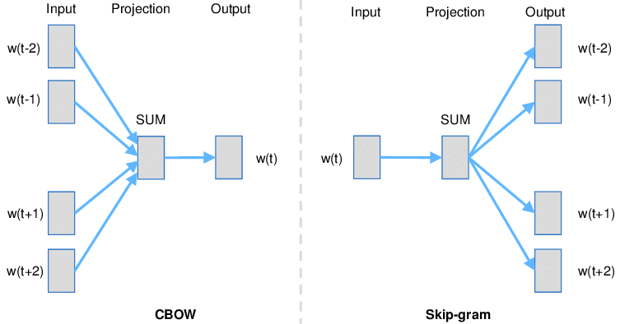
Why Skip Gram and not CBOW ?
“predicting the word given its context”
“predicting the context given a word
”

Slide 6
Proposed Model
Step 01 First of all, classes (competences) are normalized to have a common representation for competences
Step 03 Then, resumes are transformed into matrices using the trained word embedding model
Step 05 Finally, the base CNN classifiers are trained using the appropriate sub-datasets
01
03
05
02
04
Step 02 Next, a word embedding model is trained from the corpus of resumes using the skip-gram algorithm
Step 04 After that, the original multi-label dataset is splitted into n single-label dataset; each used to train a single base classifier

Slide 7

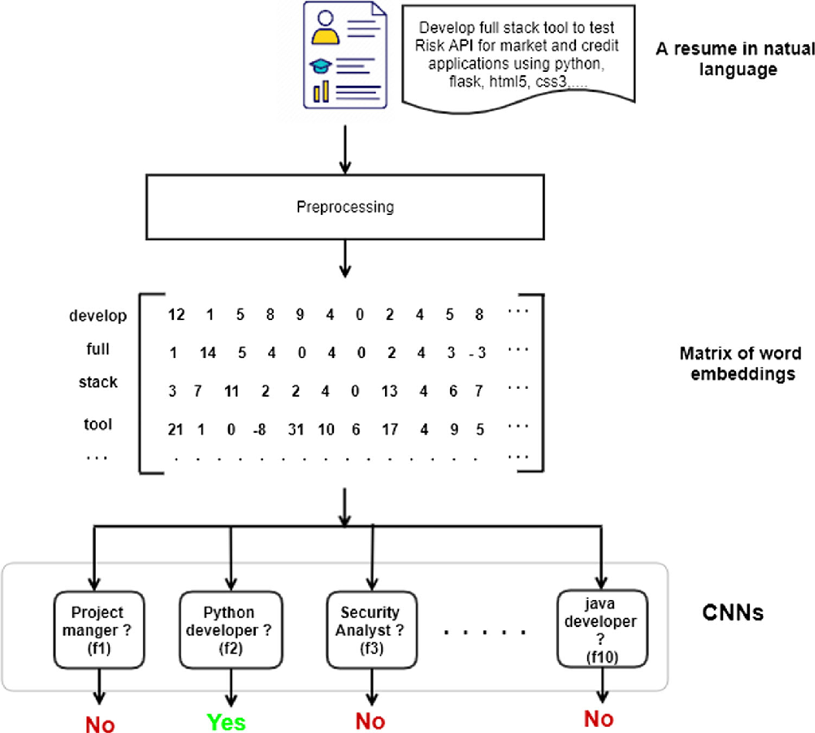
Multi-label skills prediction
Architecture model

Slide 8
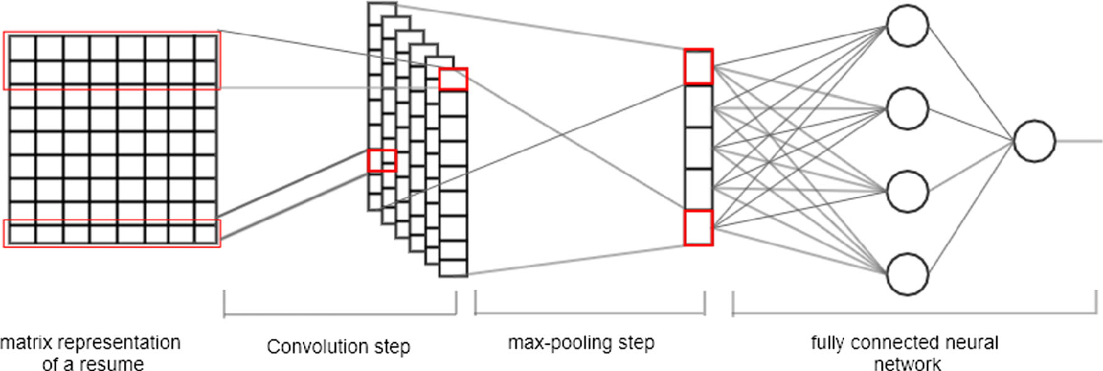
CNN architecture for text classification
n = 10
0
1
500 X 100
500X 100
100

Slide 9
Research Results
98%
Recall
91%
Precision
These many competences are well predicted by the model
This indicates that our model almost always predicts all the expected competences
Other Models
Model | Recall | Precision
Word2vec+ cnn | 0.92 | 0.84
Onehot+LR | 0.86 | 0.74
Our Results
84%
Precision
92%
Recall
This indicates that our model almost always predicts all the expected competences
These many competences are well predicted by the model

Slide 10
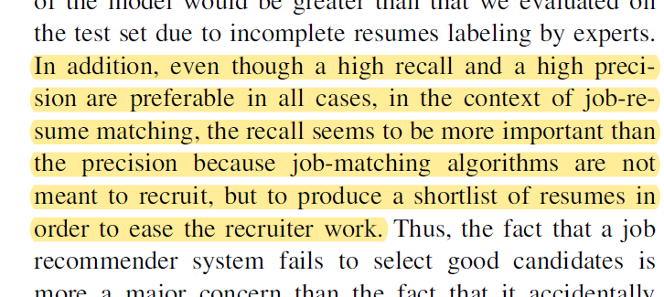
Observations
01
Observation#1 The fact that a resume has not been labeled by a particular competence does not necessarily mean that it does not express that competence. This could explain the gap between the recall and the precision.
02
Observation#2 In practice, the precision of the model would be greater than that we evaluated on the test set due to incomplete resumes labeling by experts.
03
Observation#3 In addition, even though a high recall and a high precision are preferable in all cases, in the context of job-resume matching, the recall seems to be more important than the precision because job-matching algorithms are not meant to recruit, but to shortlist the resumes
04
Observation#4 Thus, the fact that a job recommender system fails to select good candidates is more a major concern than the fact that it accidentally selects bad ones.

